Slide 1




Introduction to
Stronger Churches
Notes:
Revised February 9, 2023

Slide 2


Sessions
Passion, Vision, Mission
The Five Commitments of a Healthy Church
The Five Functions of a Healthy Church
The Transformational System

Slide 3
Passion, Vision, Mission
What is “Integral Church Growth”?
Church growth is healthy when it promotes improvement in all dimensions of a church’s life rather than just an increase in the number of members or attendees.

Slide 4
Passion, Vision, Mission
The congregation sees itself in the broad framework of the purposes of God for the world, humanity and the cosmos—renewal in all dimensions.
Seeks to be a witness of God’s Kingdom in all areas of life through the impact of the Good News of Jesus Christ.

Slide 5
Passion, Vision, Mission
A Framework for Integral Church Growth:
Vision
Having vision is looking toward the
FUTURE and seeing what God wants
to do through you in order to achieve
His redemptive purposes.

Slide 6
Passion, Vision, Mission
“Many are the plans in a man’s heart,
but it is the LORD’s purpose that prevails.”
- Proverbs 19:21

Slide 7
Passion, Vision, Mission
A Framework for Integral Church Growth:
Relationship between the Church and God
Relationship between God and the community
Relationship between a congregation and its community

Slide 8
Passion, Vision, Mission
GOD
MYSELF/
CHURCH
THE
COMMUNITY

Slide 9

Passion, Vision, Mission
GOD
PASSION
VISION
BLESSING
If not today, when?
If not I, who?
TESTIMONY
PURPOSE
CHURCH
COMMUNITY
MISSION

Slide 10


Five Commitments of a Healthy Church
Understanding these elements enables leaders
to do strategic planning and evaluate their ministries.
Clear vision
Empowering leadership
Members involved in ministry
Stewardship of resources
Connection between the text and the context

Slide 11
Five Commitments of a Healthy Church
Clear vision
Key Aspects of a Vision Statement:
It presents a clear picture of a preferred future.
It enables one to think of possibilities with God’s “eyeglasses.”
It’s based on the redemptive purposes of God.
It’s not satisfied with the status quo (the way things are at present).
It takes faith.
It’s communicated in a simple form.
It moves one toward prayer and action/it gives a sense of urgency.
It’s shared among leaders and members.

Slide 12
Five Commitments of a Healthy Church
Empowering Leadership
CHARACTERISTICS OF LEADERS IN SCRIPTURE:
The leader is sent by God.
The leader is a servant.
The leader seeks God’s guidance.
The leader motivates and equips God’s people.

Slide 13
Contrast between Leadership Styles
The Authoritarian Leader:
Says, “Follow me!”
Decides what his vision and goals are for the church.
Doesn’t delegate, just gives orders.
Makes decisions on his own.
Complains about the weaknesses of the congregation.
Does everything himself: preaching, visiting, praying, teaching, leading, worship, etc.
Sees other leaders as competitors and threats.

Slide 14
Contrast between Leadership Styles
The Servant Leader:
Says, “Let’s follow Jesus!”
Works with leaders to discern the vision and goals God has
for the church.
Involves others.
Invites others to participate in making decisions.
Strengthens the congregation in its areas of weakness.
Trains others to do ministry and affirms them.
Sees other leaders as partners and blessings.
Do you put others to work? Who in your church can you involve in different ways?

Slide 15
Five Commitments of a Healthy Church
A clear and inspiring goal
Work structured to achieve results
Competent members
Commitment of all members
A collaborative environment
A standard of excellence
Servant leadership
The members of the church work together, using their gifts responsibly in the congregation and in
the community.

Slide 16
Five Commitments of a Healthy Church
Stewardship of Resources
The Four “T’s” of Stewardship:
Time
Talent
Treasure
Temple of God (our physical bodies)
The church challenges its members to be good stewards of its possessions and goods as well as their own.

Slide 17
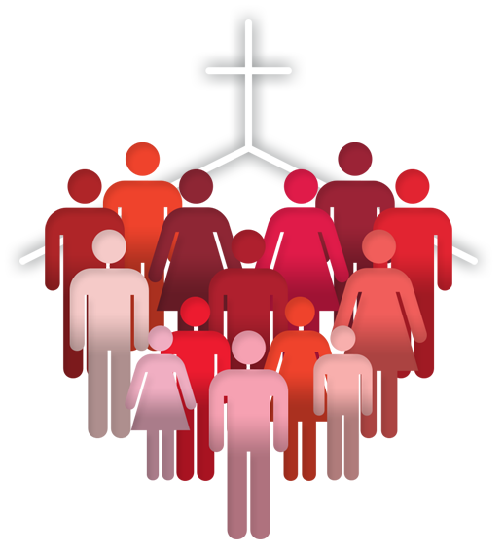
Five Commitments of a Healthy Church
Connection between the text and the context
A healthy church takes into account its context (geographic location, social and economic factors, cultures, etc.). While the message
of the good news in Jesus Christ does not change, the methods for sharing it do.

Slide 18


Five Functions of a Healthy Church
Evaluating a congregation in terms of these tasks helps
leaders in their strategic planning.
Evangelism
Discipleship
Service
Fellowship
Worship

Slide 19
Five Functions of a Healthy Church
Evangelism
The church announces, in words and deeds that people can understand, that through Jesus Christ, the Kingdom of God has come. It calls people to believe this good news, to turn their lives over to Jesus, and to become His disciples. Our lives give evidence of the new creation in Christ—a “living proclamation” of what God has done.
Questions for reflection:
To how many people have I presented the gospel in the last two months?
How many believers has our church trained to share their faith?

Slide 20
Five Functions of a Healthy Church
Evangelism
Three Kinds of Changes Needed for People to Come to Know Christ:
A CHANGE OF POWER
A CHANGE OF BELIEF
A CHANGE OF WILL

Slide 21
Five Functions of a Healthy Church
Discipleship
Conduct
Thinking
Character
Commitment
As we know Christ and His will better and depend on His Spirit,
we become more and more like Him in our:

Slide 22
Five Functions of a Healthy Church
Segmented Faith vs. Integrated Faith
As we know Christ and His will better and depend on His Spirit,
we become more and more like Him in our:

Slide 23
Five Functions of a Healthy Church
Service
As we know Christ and His will better and depend on His Spirit,
we become more and more like Him in our:
Connections between Service and Evangelism:
Service is a result of evangelism:
God’s love makes us want to serve others.
Service is a bridge to evangelism:
We do concrete acts of service first, and those acts of service open doors to share our faith.
Service accompanies evangelism:
As we serve others, we speak of God’s love for them in Christ.

Slide 24
Five Functions of a Healthy Church
Fellowship
In a healthy church, the members enjoy each other and bear one another’s burdens, showing the love and compassion of God.
  The theological basis for fellowship comes from the Trinity itself—the FIRST community (John 17).
  Already in the Old Testament, we see the value ascribed to the unity among believers (Psalm 133).

Slide 25
Five Functions of a Healthy Church
Worship
The worship service is a special time when God’s people
gather to meet with God together.
God calls us to worship Him.
We respond by praising Him together.
God calls us to confess our sins.
We respond by confessing our sins and asking forgiveness.
God speaks to us through His Word.
We respond with confessions of faith, offerings, testimonies.

Slide 26
Five Functions of a Healthy Church
Worship
The worship service is a special time when God’s people
gather to meet with God together.
God shows us His love in the Sacraments.
We receive the work of God through His Holy Spirit
God blesses us and sends us out into the world.
We leave the worship place ready to serve God.

Slide 27
Five Functions of a Healthy Church
Worship
Worship factors that can help a church to grow:
Warm welcome to visitors
Follow-up of visitors
Room for new people in the worship area
Solid biblical preaching
Clear communication

Slide 28


The Transformational System
Principle
The church is a living ORGANISM as the Body of Christ, and at the same time it exists in concrete, visible ORGANIZATIONS (congregations, denominations) through which God is at work in the world.

Slide 29

The Transformational System
Components of an Organization
External Factors that Affect a Congregation:
COMMUNITY | ENVIRONMENT
RELIGIOUS TRADITION | BIBLICAL VALUES
- - - - - - - - - - - - - - - - - - - - - - - - - - -
People
entering
- - - - - - - - - - - - - - - - - -
People
minister
- - - - - - - - - - - - - - - - - -
LOCAL
- - - - - - - - - - - - - - - - - - - - - - - - - - -
LOCATION
ORGANIZATIONAL HISTORY
CENTRAL MINISTRY VALUES

Slide 30
The Transformational System
Components of an Organization
Internal Components of a Congregation:
THE CHURCH WITH CHRIST AS HEAD
ORGANISM | ORGANIZATION
Resources
Communication
Structure
People
entering
LEADERSHIP
People
minister
VISION
Program
People
PURPOSE

Slide 31
External and Internal Components—Transformation:
THE CHURCH WITH CHRIST AS HEAD
ORGANISM | ORGANIZATION
LOCATION
God’s Kingdom
Resources
Transformation
Communication
Structure
People
entering
LEADERSHIP
People
minister
VISION
Program
People
PURPOSE
ORGANIZATION HISTORY | CENTRAL MINISTRY VALUES
FLOW OF PEOPLE | ENFOLD – BUILD – EQUIP – MOBILIZE
SPIRITUAL FORMATION | CHILDREN AND ADULTS
ANNUAL PLANNING CYCLE | PLANNING – EVALUATION – CALENDAR
FEEDBACK AND RESULTS

Slide 32

Thank you!

